Slide 1
VENUS SEAAIR LOGISTIX PVT LTD

Slide 2
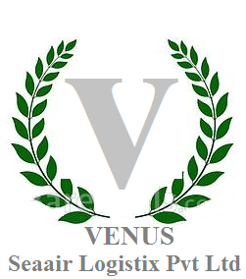
Firstly I would like to inform you that we are LCL Import consol agent handling direct consol boxes to all ports of India. We are presently handling import movements from China, France, Germany Hong Kong, Indonesia, Italy, Japan, Korea, Malaysia, Singapore, Sri Lanka, Taiwan, Thailand & USA . We can also provide you our best possible rates for FCL Shipments also.
We also handle airfreight import shipments from round the globe.

Slide 3
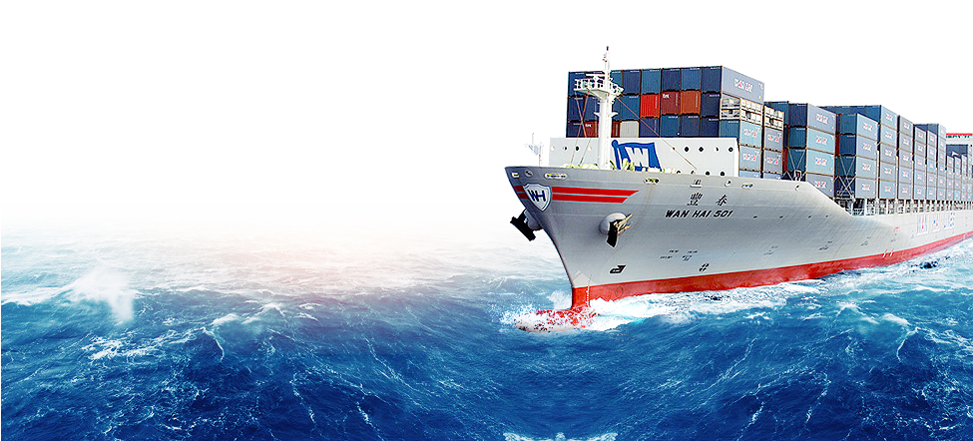
Sea Freight
NVOCC/LCL Export & Import Consolidation/ Forwarding
Container Transloading and top up operation
Inland transportation & warehousing
Customs Booking and documentation services
Special Equipment handling other then GP Containers
Handling project cargo & hazardous cargo
Petrol Chemicals – Liquid through ISO Containers
Marine Insurance arrangement

Slide 4
Air Freight
VENUS Seaair Logistix Pvt. Ltd offers you air cargo services across the globe and make for speed in delivery, and economical in costing. We attribute this to our excellent relationships that we have built up with all key global carriers.
With the IATA license of our franchisee who has office along with Venus Seaair Logistix Pvt. Ltd Offices all over India we handle issuance of import Do’s all destination in India.
Air Freight Forwarding
SERVICES

Slide 5
Truck Delivery
To cope with our customers’ different requirements, trucks of Venus Seaair Logistix Pvt. Ltd come on in all sizes, including heavy-duty trailer-hauling tractors, 10tons and 3 tons lorries. Apart from safe and reliable pick-up and delivery of cargoes, we also offer a full range of land transportation services between South India, North India, East India and West India including customs clearance: pick-up / delivery service and arrangement for loading/ unloading Cargoes.
No matter any place in the India we will delivery the goods on time with Quality and your cargoes will always get the best route and care through us.

Slide 6
Logistics Management
Venus Seair Logistix Pvt Ltd Unit manages warehousing, inventory control, cataloging, sales and purchase order processing, labeling, packaging, domestic deliveries, transportation, distribution, shipping and any other value added services.
Venus Seair Logistix Pvt Ltd Tailors total logistic solutions, allowing a customer to concentrate on his business entrusting the logistic to cargo specialists. For customers, the logistic management service has proven to be a cost effective and efficient arrangement

Slide 7
Ship Brokering
The Brokering and chartering activities of Venus Seaair Logistix Pvt. Ltd agency division specialize in dry cargo operations in Asia for worldwide destinations.
This until offers high volume tramping tonnage, maximizing cargo loading from this region for ship owners.
Ship owners are also provided with frequent updates on cargo movement, availability freight level, storage and loading/operations information at regional ports.

Slide 8
Project shipping
Venus seaair logistix Pvt Ltd ship agency division also offers floating crane tug and barge services supporting heavy project cargoes for regional operations. Operations requiring special equipment and vehicles can also be mobilized at short notice.
Venus seaair logistix Pvt. Ltd is more than shipping agency providing shipping space. A complementary in house freight forwarding and logistic management division allows Venus seaair logistix Pvt. Ltd to offer forwarding and logistics support services to customers a value added “ONE-STOP” transport and logistics solution

Slide 9
Our Goal
Since our inception, Venus Seaair Logistix Pvt. Ltd has grown in size as well as in respectability. Our dedicated and well-trained staff strives to provide premium level of service not only to local importers and exporters but also to our overseas agents and many of our parties. We strive to establish long- term relationship with our clients based on honesty, competitiveness and trust.
Turning obstacles into opportunities is what we aim for on daily basis. We find solutions to our everyday problems and try to turn them into fruitful opportunities for our future growth. At Venus Seaair Logistix Pvt. Ltd we work with sincere efforts intelligence, well found direction along with skilful execution with results in best quality service.
We specialize in moving cargoes to various destinations through our dedicated professional network

Slide 10
SERVICE QUALITY
It's our mission to provide value-added, time and cost saving services.
Track & Trace latest cargo information
Excellent Customer Service team
Flight/Vessel/
Trucking Arrangement
Good relationship with Airline and Carrier
Co-operation with Overseas office/agent
Competitive Pricing
Professional and friendly staff
Efficiency of our Company system

